Slide 1
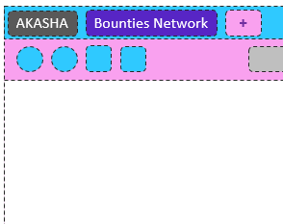
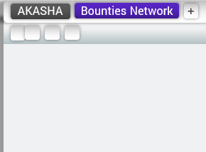
Please select your theme
Delicate
Common Design

Slide 2
AKASHA
Bounties Network
+
https://site.com

Slide 3
AKASHA
Bounties Network
+
https://site.com

